Slide 1


Slide 2
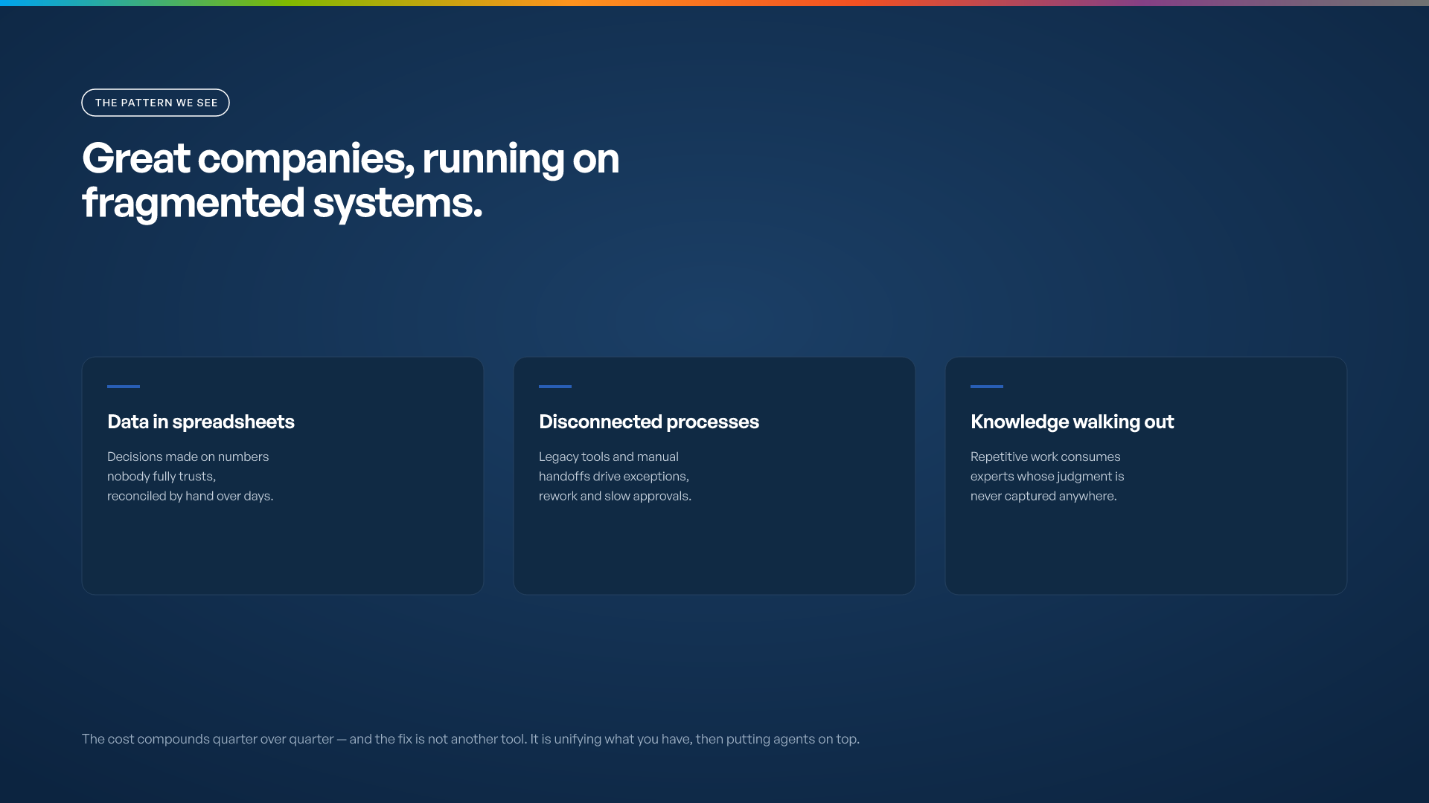

Slide 3
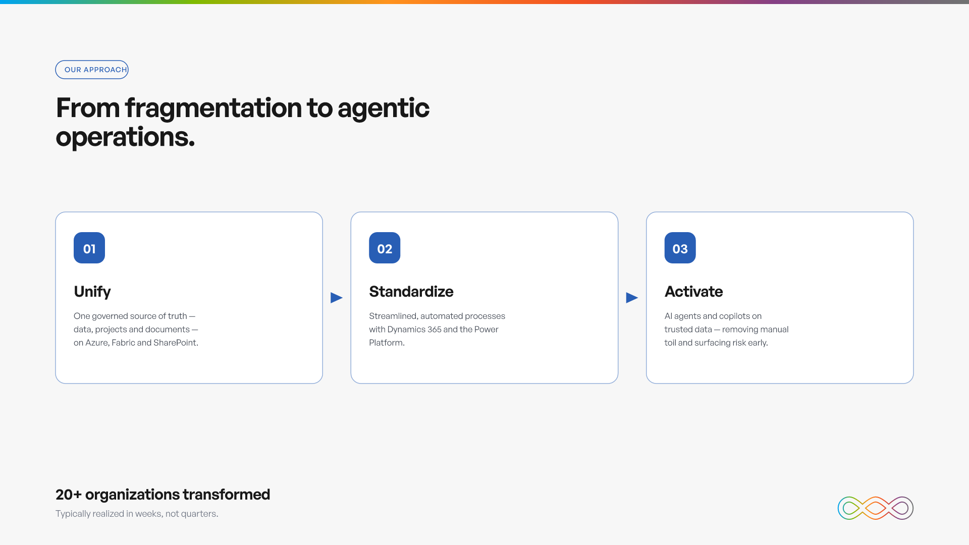

Slide 4
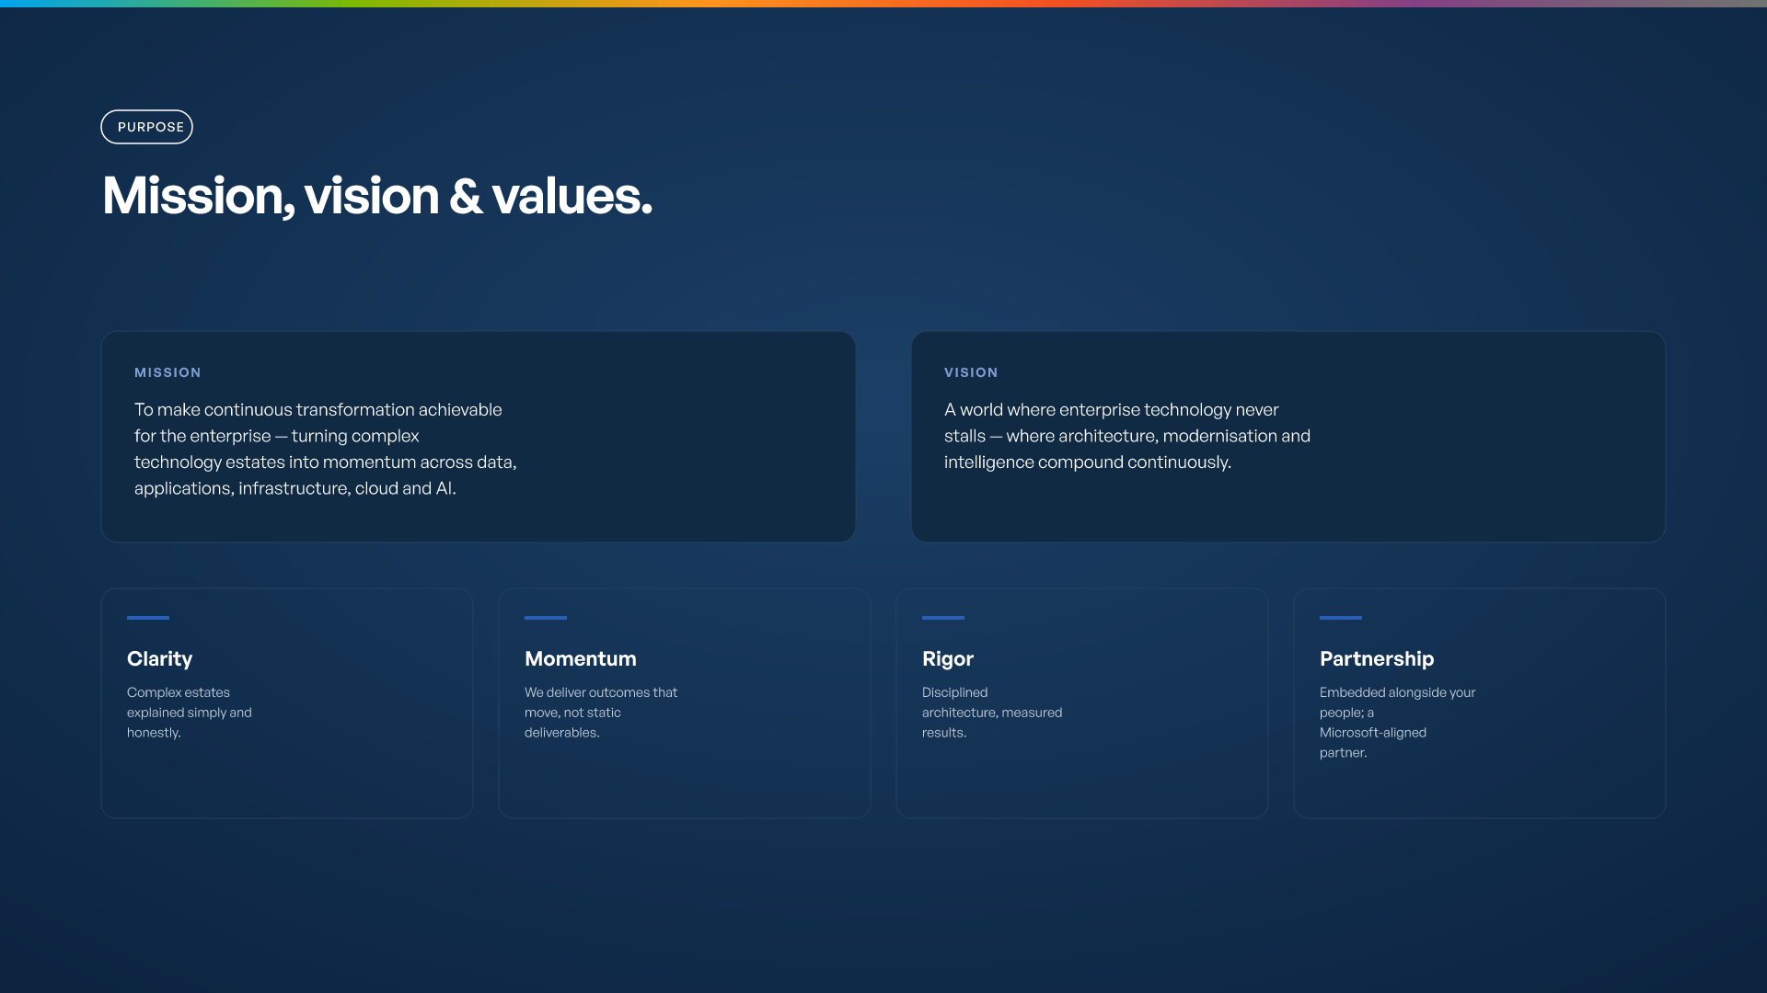

Slide 5
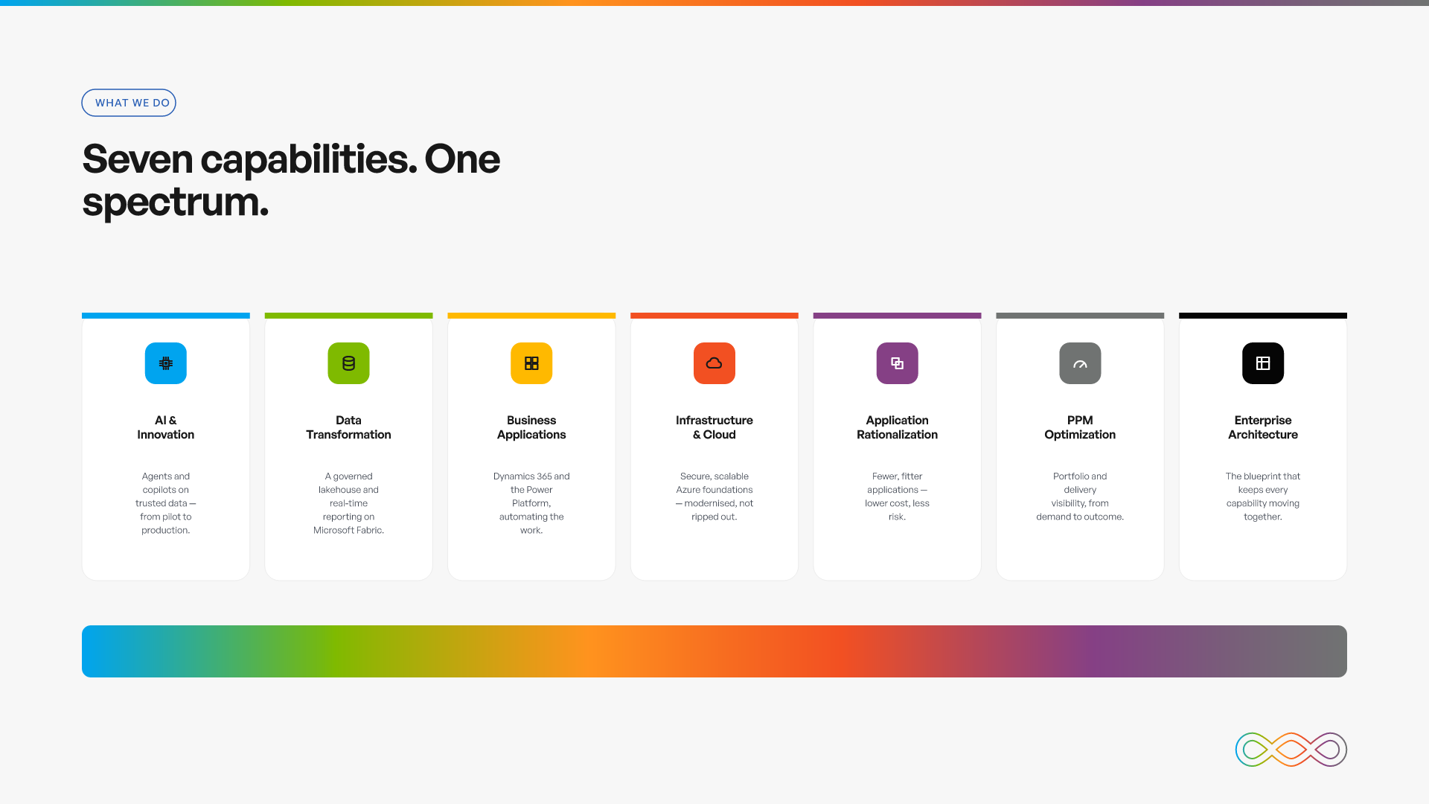

Slide 6
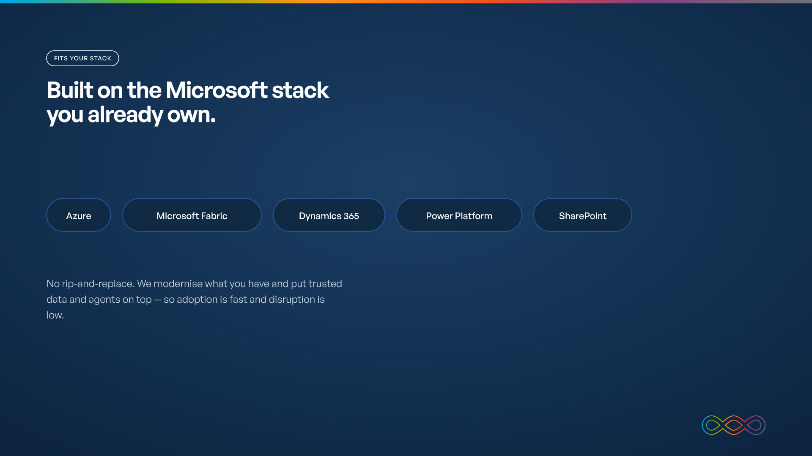

Slide 7
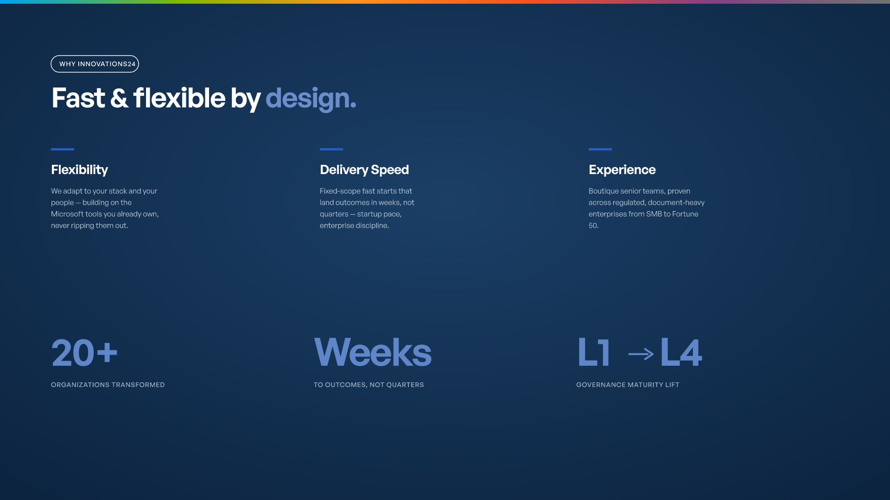

Slide 8

ON-TIME DELIVERY

Slide 9

DATA ACCURACY — OVER TWO YEARS
Time →

Slide 10
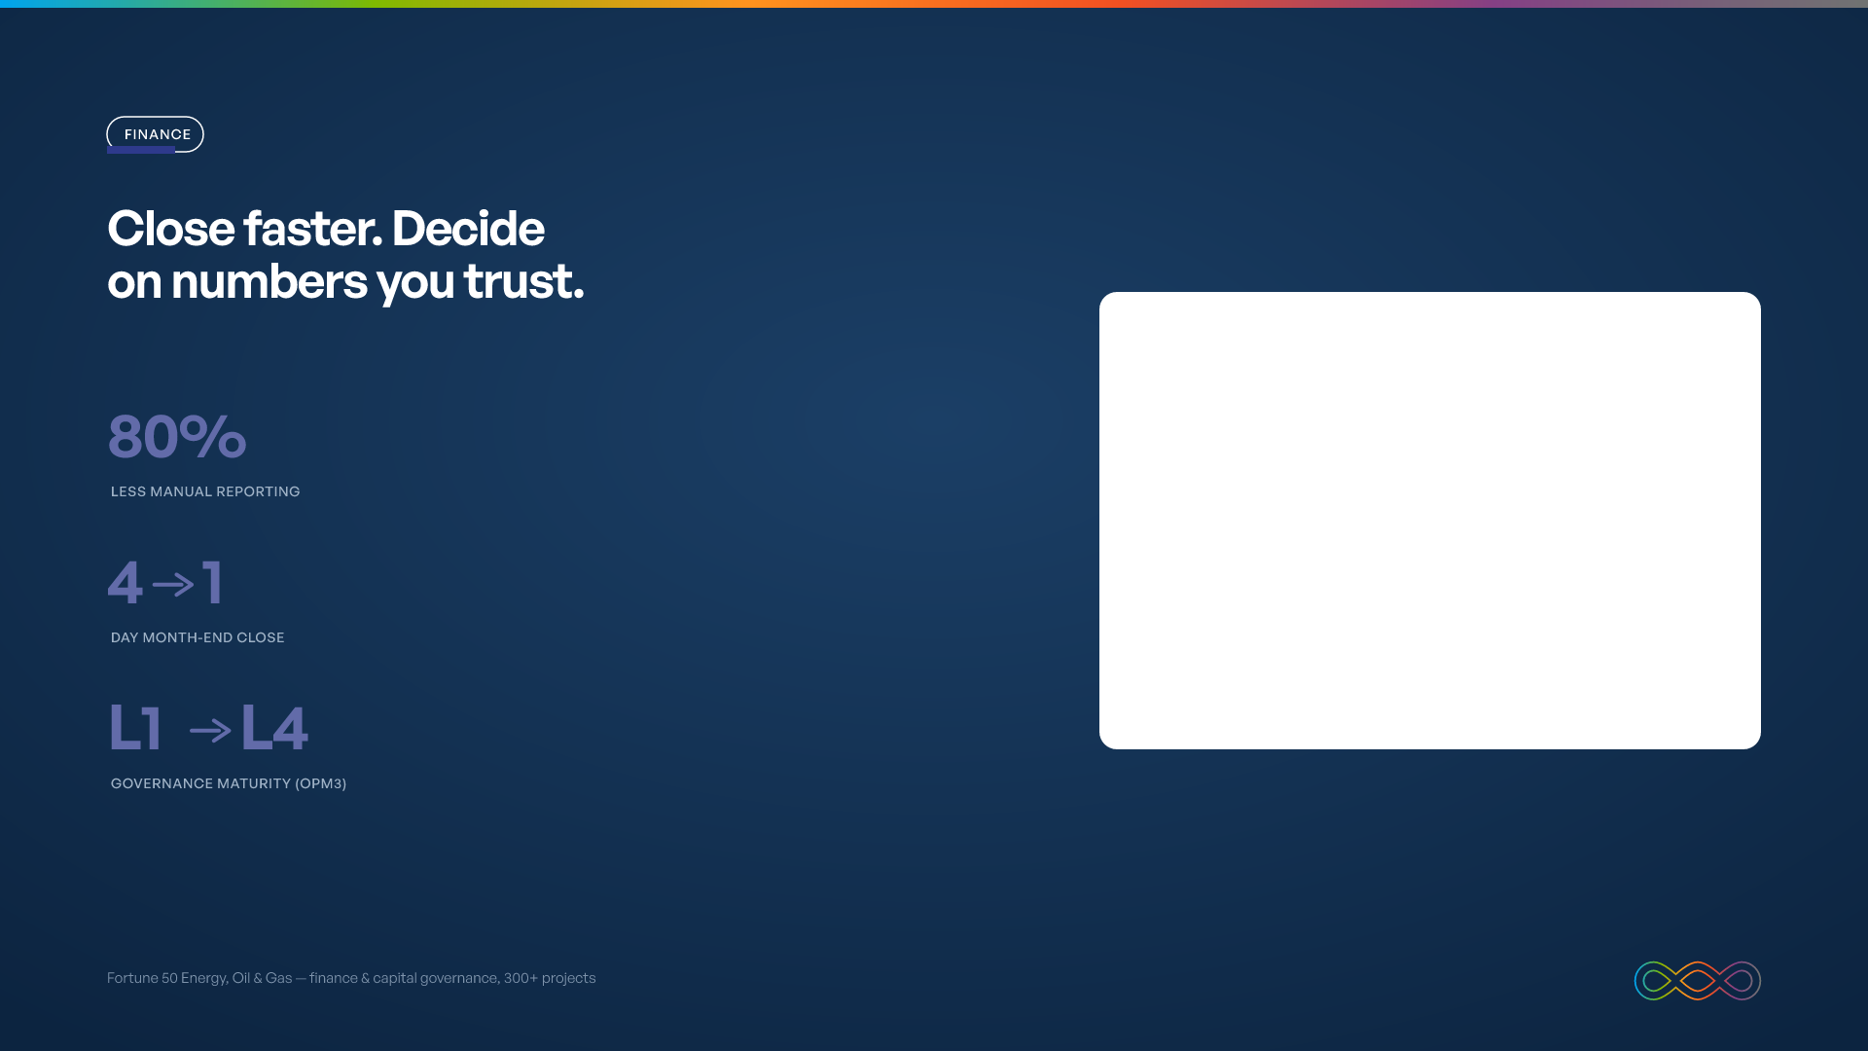
MONTH-END CLOSE (DAYS)

Slide 11
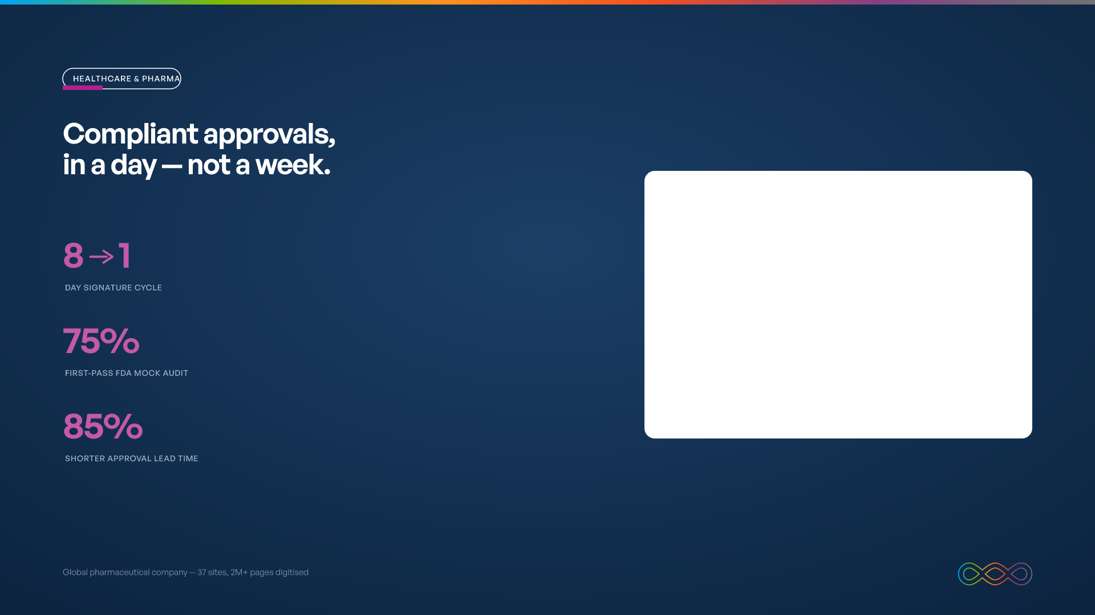
SIGNATURE CYCLE (DAYS)

Slide 12

Book a call

